Slide 1
Constraint Satisfaction Problem
Unit 3

Slide 2
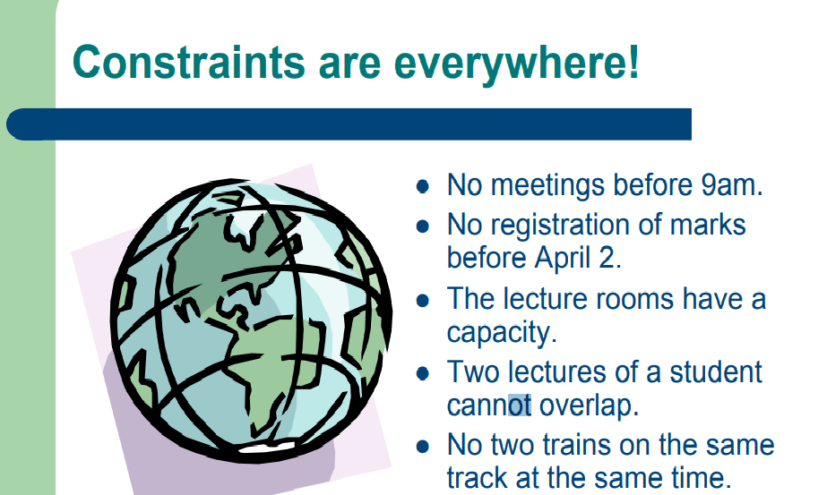

Slide 3
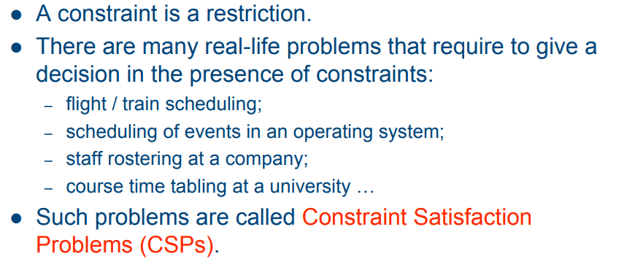
Constraint Satisfaction Problem

Slide 4
State Representation of water jug problem
(x, y) – state of a problem
Where x is the amount of water in 4 liter jug
y- is the amount of water in 3 lit jug
0 <= x <= 4 and 0 <= y <= 3
Initial state – (0, 0)
Goal state – (2, y) where 0 <= y <=3

Slide 5
Operations:
Fill 4 lit jug (x ,y) -→ (4, y) if x < 4
Fill 3 lit jug (x, y) → (X, 3) if y < 3
Empty 4 lit jug (x , y) → (0, y) if x> 0
Empty 3 lit jug (x , y) → (x, 0) if y> 0

Slide 6
Operations:
5)Pour water from 3 lit (x ,y) -→ (4, y-(4-x)) if 0 < x+y >=4 & y>0
jug to 4 lit jug
6)Pour water from 4 lit (x ,y) -→ (x-(3-y), 3) if 0 < x+y >= 3 & x>0
jug to 3 lit jug
7)Pour all water from 3 (x , y) → (x+y, 0) if 0<x+y<=4 & y>=0
lit jug to 4 lit jug
8)Pour all water from 4 (x , y) → (0, x+y) if 0<x+y<=3 & x>0
lit jug to 3 lit jug

Slide 7
Variation on the CSP formalism
Types of variables in CSPs
The simplest kind of CSP involves variables that have discrete, finite domains.
E.g. Map-coloring problems, scheduling with time limits, the 8-queens problem.
A discrete domain can be infinite.
e.g. The set of integers or strings, job scheduling without time limit.
The best known category of continuous-domain CSPs is that of linear programming problems, where constraints must be linear equalities or inequalities. Linear programming problems can be solved in time polynomial in the number of variables.

Slide 8
Types of constraints in CSPs
The simplest type is the unary constraint, which restricts the value of a single variable.
A binary constraint relates two variables. (e.g. SA≠NSW.) A binary CSP is one with only binary constraints, can be represented as a constraint graph.
We can also describe higher-order constraints. (e.g. The ternary constraint Between(X, Y, Z).)
A constraint involving an arbitrary number of variables is called a global constraint

Slide 9
One of the most common global constraint is Alldiff, which says that all of the variables involved in the constraint must have different values.
Constraint hypergraph: consists of ordinary nodes (circles in the figure) and hypernodes (the squares), which represent n-ary constraints.

Slide 10
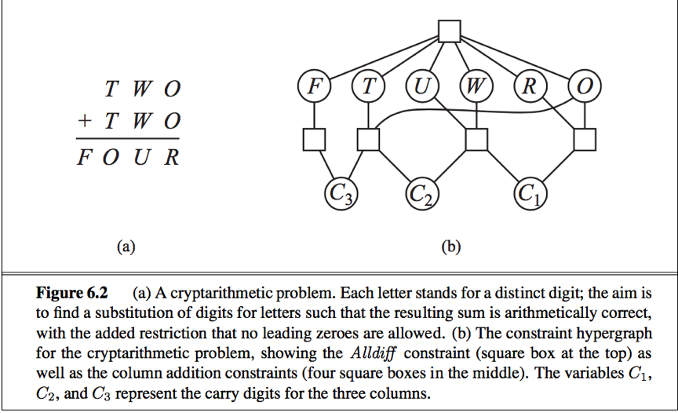
O + 0 = R + 10 * C1
C1 + W + W= U + 10 * C2
C2 + T + T = O + 10 * C3
C3 = F

Slide 11
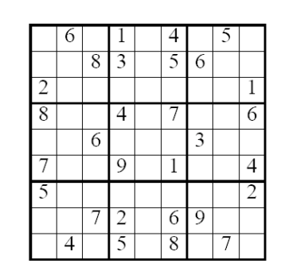
Sudoku: An everyday-life example

Slide 12
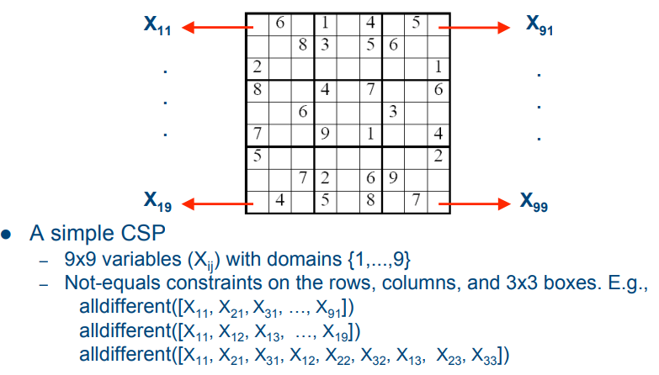

Slide 13
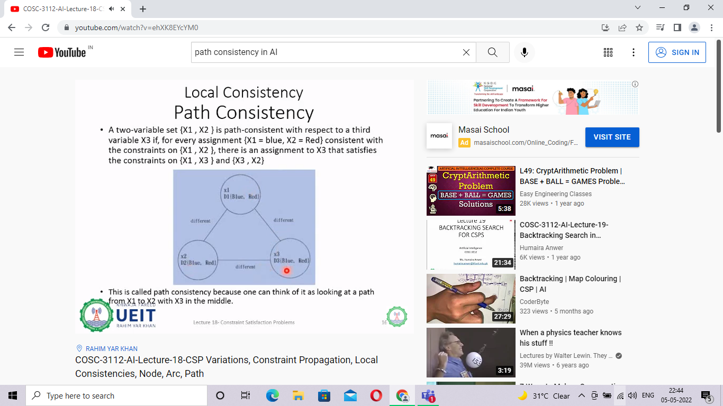

Slide 14
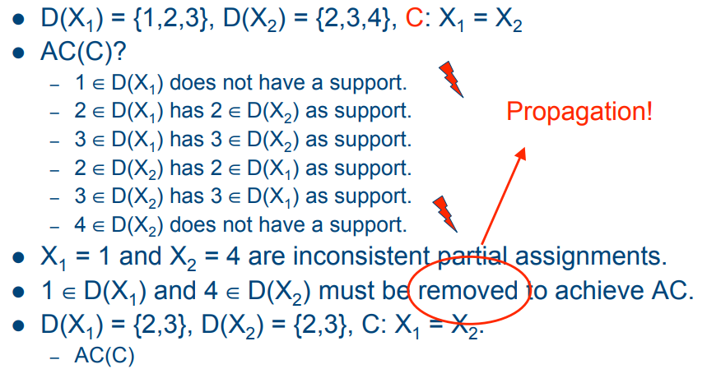

Slide 15
Local search for CSP
In constraint satisfaction, local search is an incomplete method for finding a solution to a problem.
It is based on iteratively improving an assignment of the variables until all constraints are satisfied.
In particular, local search algorithms typically modify the value of a variable in an assignment at each step.
The new assignment is close to the previous one in the space of assignment, hence the name local search.

Slide 16
Local search for CSP
All local search algorithms use a function that evaluates the quality of assignment,
for example
the number of constraints violated by the assignment.
This amount is called the cost of the assignment.
The aim of local search is that of finding an assignment of minimal cost, which is a solution if any exists.

Slide 17
Local search for CSP
Two classes of local search algorithms exist.
Greedy or non-randomized algorithms.
These algorithms proceed by changing the current assignment by always trying to decrease (or at least, non-increase) its cost. The main problem of these algorithms is the possible presence of plateaus, which are regions of the space of assignments where no local move decreases cost.
Randomized local search
The second class of local search algorithm have been invented to solve this problem. They escape these plateaus by doing random moves, and are called randomized local search algorithms.

Slide 18
Greedy algorithms
Hill climbing
choosing the change that maximally decreases the cost of the solution.
This method, called hill climbing, proceeds as follows:
first, a random assignment is chosen;
then, a value is changed so as to maximally improve the quality of the resulting assignment.
If no solution has been found after a given number of changes, a new random assignment is selected.
Hill climbing algorithms can only escape a plateau by doing changes that do not change the quality of the assignment.
As a result, they can be stuck in a plateau where the quality of assignment has a local maxima.

Slide 19
Greedy algorithms
Tabu search
A drawback of hill climbing with moves that do not decrease cost is that it may cycle over assignments of the same cost. Tabu search^{[1][2][3]} overcomes this problem by maintaining a list of "forbidden" assignments, called the tabu list. In particular, the tabu list typically contains only the most recent changes. More precisely, it contains the last variable-value pair such that the variable has been recently assigned to the value.
This list is updated every time the assignment is changed. If a variable is assigned to a value, the variable-value pair is added to the list, and the oldest pair is removed from it. This way, the list only contains the most recent assignments to a variable. If a variable-value pair is in the tabu list, then changing the current assignment by setting the variable to the value is forbidden. The algorithm can only choose the best move among the ones that are not forbidden. This way, it cannot cycle over the same solution unless the number of moves in this cycle is larger than the length of the tabu list.

Slide 20
Sample Questions
What is constraint satisfaction problem? Explain with example.
How to define/represent/formulate any CSP problem?
What is constraint propagation & local consistency in CSP?
What is node consistency and arc consistency? Explain with example.
What is path consistency?
What is constraint graph?
How backtracking is used in CSP? Explain with example.

